Slide 1
Data Mining Topic: Data Exploration
Dr. J Angel Arul Jothi
Department of Computer Science

Slide 2
Text Book Chapter 3

Slide 3
Data exploration
What?
Preliminary investigation of the data in order to better understand its specific characteristics
Motivation of data exploration
Help to select the right tool for preprocessing or analysis
Techniques
Summary statistics
Visualization

Slide 4
Iris Data Set
Many of the exploratory data techniques are illustrated with the Iris Plant data set.
Can be obtained from the UCI Machine Learning Repository http://www.ics.uci.edu/~mlearn/MLRepository.html
From the statistician Douglas Fisher
Three flower types (classes)
Setosa
Virginica
Versicolour
Four (non-class) attributes
Sepal width and length
Petal width and length

Slide 5
Summary Statistics
Summary statistics are used to capture various properties of a large data with a single number or a small set of numbers
Measures of Location: Mean and Median
Frequency, Mode
Measures of spread: Range, Variance
Percentiles
Multivariate Summary Statistics: Covariance, Correlation

Slide 6

Mean
Let {x₁, x₂, . . . , x_{N}} be a set of N values for some continuous attribute x
The mean of this set of values is
Weighted mean: Weight is associated with each value (domain knowledge)
Mean is very sensitive to outliers
Use trimmed mean – remove top and bottom extreme (2%) values and compute the mean

Slide 7

Mean:Example
Suppose we have the following values for salary (in thousands of dollars), shown in increasing order compute the mean
Values: 30, 36, 47, 50, 52, 52, 56, 60, 63, 70, 70, 110
Answer: $58,000

Slide 8
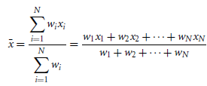
Weighted arithmetic mean
Also called as weighted average
Sometimes, each value xi may be associated with a weight wi for i = 1, … , N which denotes the significance of the value

Slide 9
Trimmed mean
The mean obtained after chopping off values the high and low extremes
p% Trimmed mean:
Sort the values observed for an attribute
Remove the top and bottom p% of values
Compute the mean

Slide 10
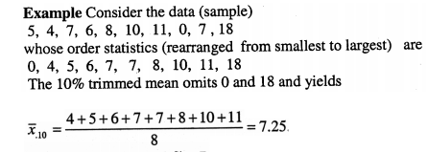
Trimmed mean:Example
Compute 10% and 20% trimmed mean

Slide 11

Trimmed mean:Example
Sort the data

Slide 12
Mean
Observations:
Single most useful quantity for describing a data set
Provides the middle of a set of values when data is symmetric
It is not the best way of measuring the center of skewed or asymmetric data

Slide 13
Median
Provides the middle of a set of values for skewed or asymmetric numeric data
For a given set of ordered attribute values the median is the
Middle value, if there are an odd number of values
Average of the two middle values if the number of values is even
The median provides a more robust estimate of the middle of a set of values when compared to mean
Example: Consider the set of values {1, 2, 3, 4, 5, 90}
The mean of these values is 17.5, while the median is 3.5

Slide 14
Frequency and Mode
Given an attribute x, which can take values {v₁, . . . v_{k}}, the frequency of a value v_{i} is defined as the number of times a value v_{i} occurs in the set of objects
The mode of an attribute is the most frequently occurring attribute value
Frequency and Mode are used with categorical data
It is possible for the greatest frequency to correspond to several different values, which results in more than one mode (multimodal)
One, two, or three modes are respectively called unimodal, bimodal, and trimodal

Slide 15
Frequency & Mode: Example
Suppose we have the following values for salary (in thousands of dollars), shown in increasing order: 30, 36, 47, 50, 52, 52, 56, 60, 63, 70, 70, 110. Compute the frequency and the mode.

Slide 16
Frequency & Mode: Example
Suppose we have the following values for salary (in thousands of dollars), shown in increasing order: 30, 36, 47, 50, 52, 52, 56, 60, 63, 70, 70, 110. Compute the frequency and the mode.
Frequency of values 30, 36, 47, 50, 56, 60, 63, 110 is 1
Frequency of values 52 and 70 is 2
Hence there are two modes: $52,000 and $70,000
The data is bimodal

Slide 17
Measures of Spread
Spread is also called as data dispersion
Statistics for continuous data
Tells how well the data is distributed
Indicate if the attribute values are widely spread out or if they are relatively concentrated around a single point such as the mean

Slide 18

Measures of Spread: Range
Range is the difference between the maximum and minimum values of an attribute
Given an attribute x with a set of m values {x₁, . . . , x_{m}}, range is defined as
Can be misleading if most of the values are concentrated in a narrow band of values, but there are also a relatively small number of more extreme values

Slide 19
Measures of Spread: Range
Example:
Data (in thousands of dollars): 30, 36, 47, 50, 52, 52, 56, 60, 63, 70, 70, 110
Range = ?
Range = 110 -30 = $80,000

Slide 20
Measures of Spread: Variance
The variance and standard deviation are the most common measure of the spread of a set of points
Standard deviation S_{x} is the square root of variance
A low standard deviation means that the data observations tend to be very close to the mean, while a high standard deviation indicates that the data are spread out over a large range of values
However, this is also sensitive to outliers, as it is dependent on mean

Slide 21
Variance:Example
Consider the data (in thousands of dollars):
30, 36, 47, 50, 52, 52, 56, 60, 63, 70, 70, 110
Compute the variance and standard deviation

Slide 22
Variance:Example
x | x_{i}-x* | (x_{i}-x*)²
30 | 30- 58 = -28 | 784
36 | 36 – 58 = -22 | 484
47 | 47-58 = -11 | 121
50 | 50-58 = -8 | 64
52 | 52-58 = -6 | 36
52 | 52-58 = -6 | 36
56 | 56-58 = -2 | 4
60 | 60-58 = 2 | 4
63 | 63-58 = 5 | 25
70 | 70-58 = 12 | 144
70 | 70-58 = 12 | 144
110 | 110-58 = 52 | 2704
Data (in thousands of dollars):
30, 36, 47, 50, 52, 52, 56, 60, 63, 70, 70, 110
Mean = 58
Sum (x_{i}-x*)²= 4550
Variance = 4500/11 = 413.63
Standard deviation =20.3

Slide 23
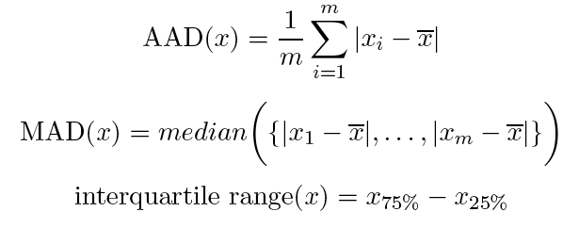
Other Measures of Spread
More robust measures of spread are
Absolute average deviation (AAD) also called as mean absolute deviation
Median absolute deviation (MAD)
Interquartile range(IQR)

Slide 24

AAD:Example
Data (in thousands of dollars):
30, 36, 47, 50, 52, 52, 56, 60, 63, 70, 70, 110
Find absolute average deviation (AAD)

Slide 25
AAD:Example
x | |xi-x*|
30 | 30- 58 = 28
36 | 36 – 58 = 22
47 | 47-58 = 11
50 | 50-58 = 8
52 | 52-58 = 6
52 | 52-58 = 6
56 | 56-58 = 2
60 | 60-58 = 2
63 | 63-58 = 5
70 | 70-58 = 12
70 | 70-58 = 12
110 | 110-58 = 52
Data (in thousands of dollars):
30, 36, 47, 50, 52, 52, 56, 60, 63, 70, 70, 110
Find absolute average deviation (AAD)
AAD =(28+22+11+8+6+6+2+2+5+12+12+52)/12
=$13,833

Slide 26

MAD:Example
Data (in thousands of dollars):
30, 36, 47, 50, 52, 52, 56, 60, 63, 70, 70, 110
Find Median absolute deviation (MAD)

Slide 27
MAD:Example
x | |xi-x*|
30 | 30- 58 = 28
36 | 36 – 58 = 22
47 | 47-58 = 11
50 | 50-58 = 8
52 | 52-58 = 6
52 | 52-58 = 6
56 | 56-58 = 2
60 | 60-58 = 2
63 | 63-58 = 5
70 | 70-58 = 12
70 | 70-58 = 12
110 | 110-58 = 52
Data (in thousands of dollars):
30, 36, 47, 50, 52, 52, 56, 60, 63, 70, 70, 110
Find Median absolute deviation (MAD)
MAD = median (28,22,1,8,6,6,2,2, 5,12,12,52)
= Median (2, 2, 5, 6, 6, 8, 11, 12, 12,22,28,52)
= (8+11)/2
=19/2 =9.5 = $9,500

Slide 28
Percentile
For ordinal or continuous attribute, the notion of a percentile is more useful
Given an ordinal or continuous attribute x with values in sorted order as {x₁, x₂, …, x_{m}} and a number p between 0 and 100, the p^{th} percentile x_{p} is a value of x such that p% of the observed values of x are less than x_{p}
For instance, the 50th percentile is the value such that 50% of all values of x are less than x₅₀

Slide 29
Percentile:Example
Data (in thousands of dollars):
30, 36, 47, 50, 52, 52, 56, 60, 63, 70, 70, 110
Find IQR
x₂₅ =25/100 *12 = 3rd data = 47
x₇₅ = 75/100 *12 = 9th data = 63
IQR = 63 – 47 = $16,000

Slide 30
Multivariate Summary Statistics
Mean and median for multiple variables
Compute the mean or median separately for each attribute
For data with continuous variables, spread can be captured by covariance matrix S and
nxn matrix where n is the number of variables/attributes
The covariance matrix has the variances of the attributes along the diagonal since covariance(xi, xi) = variance(xi)
To identify the relation between two attributes we use correlation matrix R
The diagonal entries of R are correlation(xi, xi) = 1
Other entries are between −1 and 1

Slide 31
Visualization
Visualization is the display of data in graphical or tabular format so that the characteristics of the data and the relationships among data items or attributes can be analyzed or reported easily
Motivation
Humans have a well developed ability to analyze large amounts of information that is presented visually
Can detect general patterns and trends
Can detect outliers and unusual patterns

Slide 32
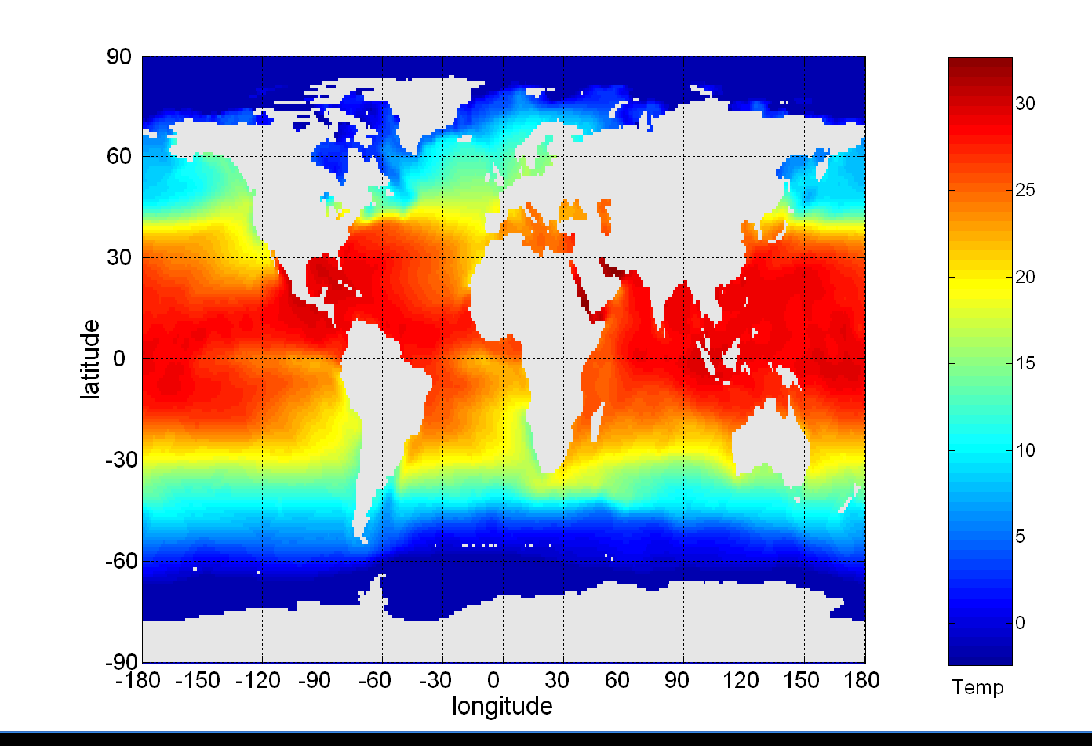
Example: Sea Surface Temperature
The following shows the Sea Surface Temperature (SST) for July 1982
250,000 data points are summarized in a single figure

Slide 33
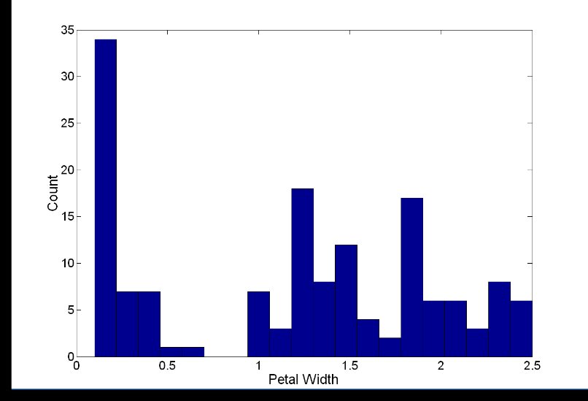
Visualization Techniques: Histograms
Histogram
Usually shows the distribution of values of a single variable
Divide the values into bins and show a bar indicating the number of objects in each bin
Shape of histogram depends on the number of bins
For categorical data, each value is a bin
For continuous attributes, the range of values is divided into bins (equal width)
Example: Petal Width (20 bins)

Slide 34
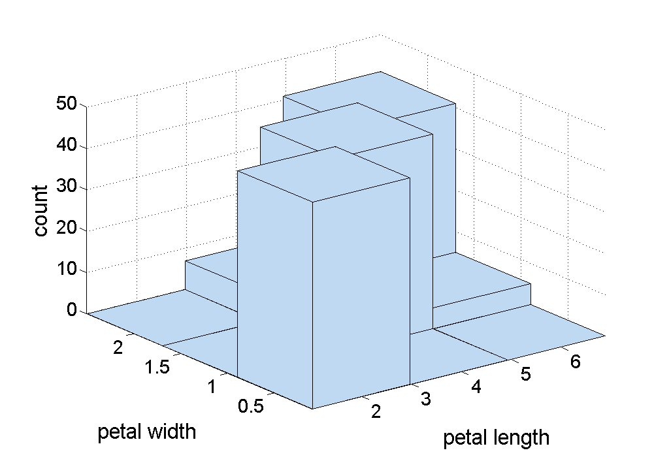
Visualization Techniques: Histograms
Two-dimensional Histogram
Helps to discover interesting facts about how the values of two attributes co-occur
Each attribute is divided into intervals and the two sets of intervals define two-dimensional rectangles of values
The height of each rectangular bar indicates the number of objects that fall into each bin
Example: Two-dimensional histogram of petal length and width in the Iris data set

Slide 35
Visualization Techniques: Box Plots
Box plot for sepal length
Box Plots
Invented by J. Tukey
Displays the distribution of data values of a single numerical attribute
Figure shows the basic part of a box plot
outlier
90th percentile
75th percentile
50th percentile
25th percentile
10th percentile

Slide 36
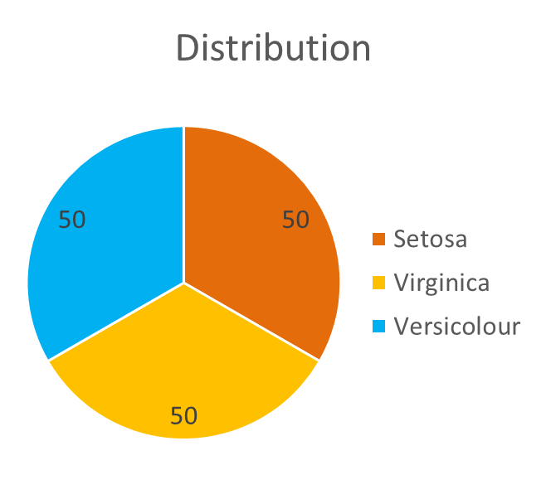
Visualization Techniques: Pie charts
Pie Chart
Used with categorical attributes that have a relatively small number of values
A pie chart uses the relative area of a circle to indicate relative frequency

Slide 37
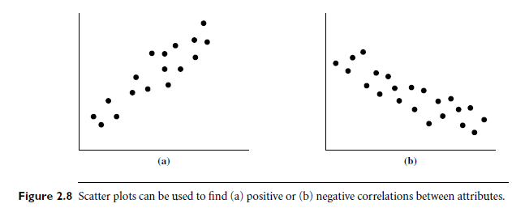
Visualization Techniques: Scatter Plots
Shows linear correlation between attributes
Two-dimensional (between two attributes) scatter plots most common

Slide 38
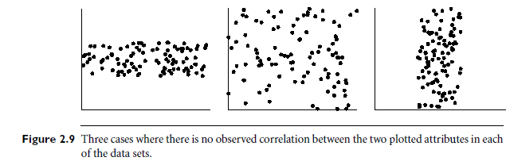
Visualization Techniques: Scatter Plots

Slide 39
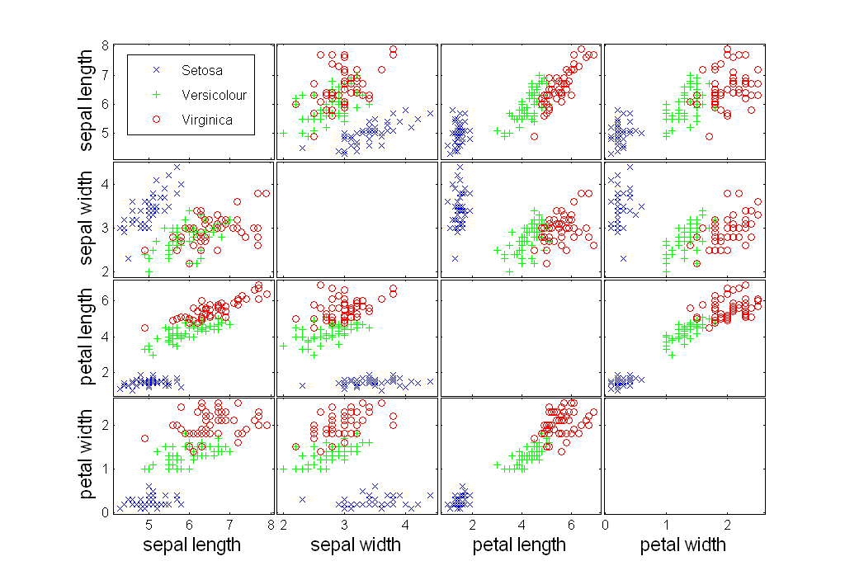
Scatter Plot Array of Iris Attributes

Slide 40
Visualization Techniques: Stem and Leaf Plots
Used to provide insight into the distribution of one-dimensional integer or continuous data
Split the values into groups, where each group contains those values that are the same except for the last digit
Each group becomes a stem, while the last digits of a group are the leaves
e.g., 35, 36, 42, and 51
Stems will be the high-order digits, e.g., 3, 4, and 5
Leaves are the low-order digits, e.g., 1, 2, 5, and 6
Plot the stems vertically and leaves horizontally

Slide 41
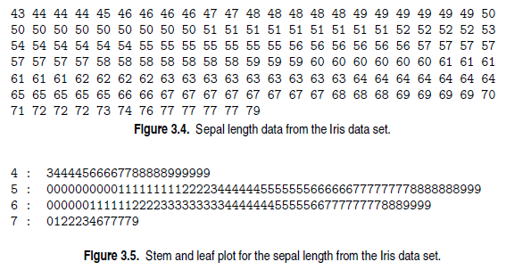
Visualization Techniques: Stem and Leaf Plots

Slide 42
Contour plots
Used for three-dimensional data
Two attributes specify a position in a plane, the third has a continuous value, such as temperature or elevation
Contour plot, breaks the plane into separate regions where the values of the third attribute (temperature, elevation) are roughly the same

Slide 43
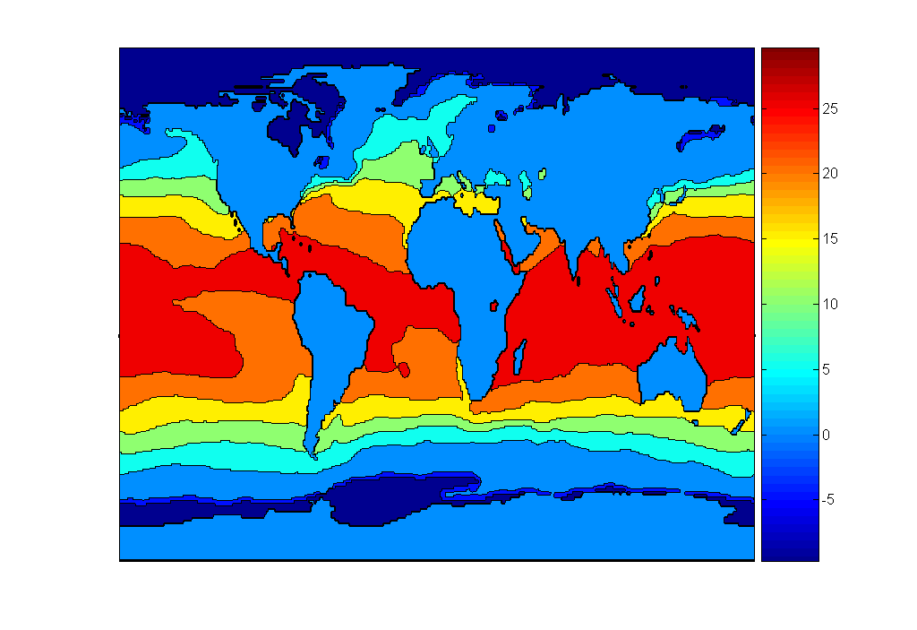
Contour Plot Example: SST Dec, 1998
Celsius

Slide 44
Thank you

